Slide 1
GIPA in Action
– PLHIV leadership in the development of a PLHIV quality of life scale for the community, health and policy sector
Graham Brown
Gosia Mikolajczak
Jen Power
Anthony Lyons
Notes:
“I want to begin my presentation by thanking the people living with HIV who have generously shared their time, experience, and body for the purposes of research throughout the epidemic. Much of the fight against HIV and AIDS relies upon people living with HIV continuing to put themselves forward and our fight against HIV is indebted to those past and present.”
The greater and meaningful involvement of people with HIV/AIDS (or GIPA) has been a foundation of effective responses to HIV.
However, in research this has often been limited to consultation rather than full collaboration.
To improve evaluation of community and health services and enhance evidence for advocacy, HIV organisations needed a short, empirically validated scale that could easily be incorporated into day-to-day practice of programs/services
Already available scales are generally very long and impractical to day to day service delivery.
To respond to the challenge we needed a real partnership
A partnership of PLHIV peer organisations, researchers, and health industry was established to pool resources and develop the PozQoL scale.
This partnership was committed to GIPA being at the centre of the process.

Slide 2
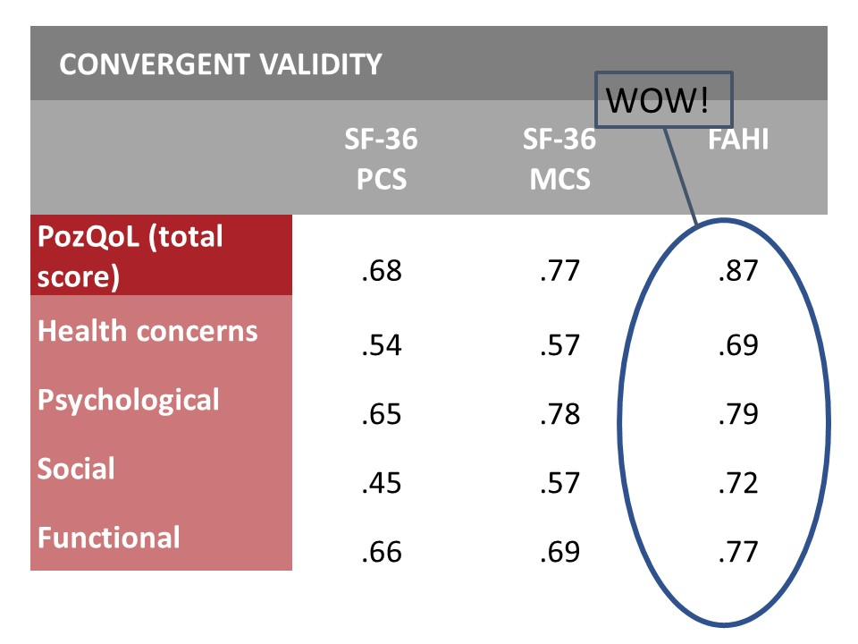
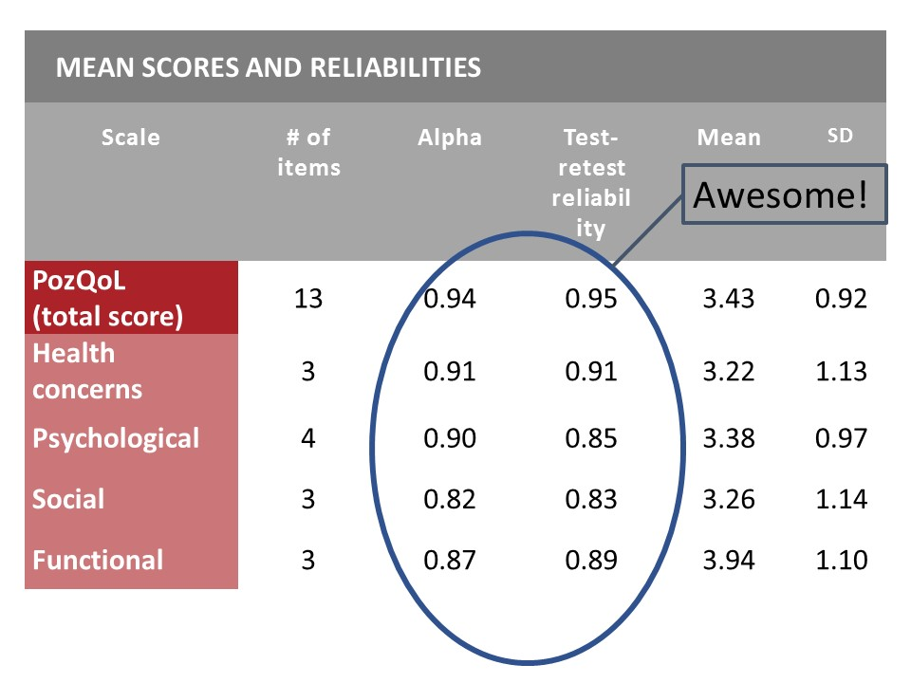
What is the PozQoL Scale
13 items across 4 domains
Health concerns | I worry about my health
 | I worry about the impact of HIV on my health
 | I fear the health effects of HIV as I get older
Psychological | I am enjoying life
 | I feel in control of my life
 | I am optimistic about my future
 | I feel good about myself as a person
Social | I feel that HIV limits my personal relationships
 | I lack a sense of belonging with people around me
 | I am afraid that people might reject me when they learn I have HIV
Functional | I feel that HIV prevents me from doing as much as I would like
 | Having HIV limits my opportunities in life
 | Managing HIV wears me out
Notes:
From discussions back in 2015 led by our PLHIV organisations in Australia – we pooled resources across community, healthcare and research. We then put forward a joint proposal to ViiV Healthcare who supported us to undertake the next larger stage
2 years of intense developmental and background work,
prioritising domains and over a 100 draft items, and then
undertaking national study with 465 PLHIV across Australia to complete a survey to create a survey,
so we could analyse the data and identify the best and shortest list of items that would provide a valid and reliable insight into QoL for PLHIV, but still correlate with larger quality of life and resilience scales.
It is quite an achievement to go from 100 draft items down to these 13 items across four domains – and have these achieve such strong reliability and validity results.
More details in the poster and handouts – but in statistical terms the results were….click WOW and ….click Amazing
The huge support from the PLHIV community and many many organisations across the sector - has brought us to where we are now.

Slide 3
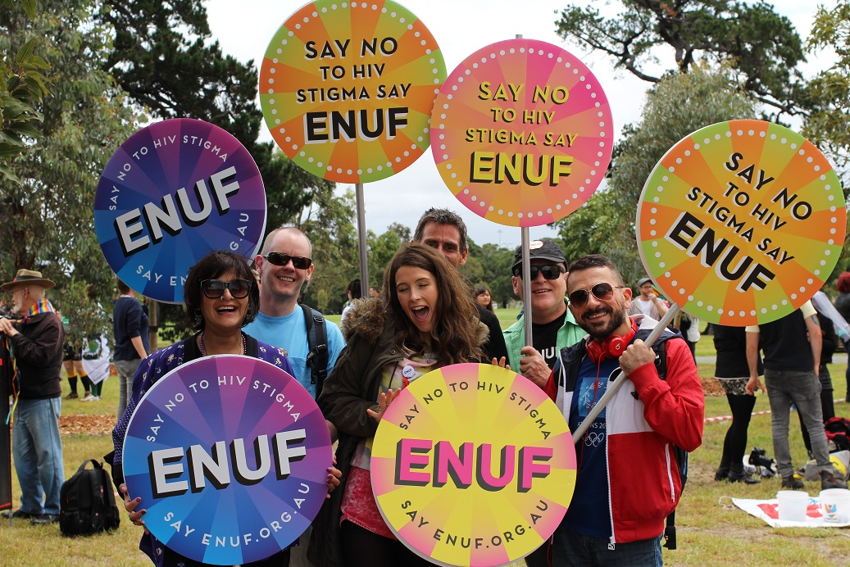
How did we meaningfully embed GIPA?
What did greater and meaningful involvement achieve?
Notes:
One of the key factors that helped us achieve these results embedding GIPA principles of a direct partnership with peer-led organisations representing people living with HIV.
So, How did we meaningfully embed GIPA?
conceptualisation and prioritisation of the domains,
development of items,
promotion and community engagement, and
decisions concerning the refinement of the final scale – in other words –direct involvement in key data analysis decisions.
What did greater and meaningful involvement achieve?
Contributed a deeper understanding of the complexity of the experience of PLHIV.
Ensured the balancing of statistical rigour, lived experience accuracy, and practical use.
Strengthened the relationship across research, community and industry
Non-reliance on individuals with HIV:
For example – while having a researcher such as myself who happens to have HIV was a asset - that is not enough to tick meaningful involvement.
I don’t have the breadth of on the ground insights of a rapidly changing community.
Credibility and authenticity within the PLHIV community was demonstrated through action more than reputation
The PozQoL scale is currently being field-tested by 15 community, support and healthcare programs for PLHIV in Australia, and being used in national surveys of PLHIV in Australia and the USA, and has been translated into Spanish.
The development of the PozQoL has demonstrated the benefits of full collaboration to achieve high quality research outcomes.
Thank you…colleagues across the partner and collaborating organisations and the 465 PLHIV who completed a survey to create a survey!!! – a demonstration of the commitment of PLHIV to research

